Slide 1
Instructors :
Dr. Jyothsna Datti mam
Loan Default Prediction Using Random Forest and Gradient Boosting
Team Memebers:
M.Nishant- 2520030323
M.Ram Ratan- 2520030291

Slide 2
Defaults Are Binary
Loan default is a binary classification with real economic impact: predict if a borrower will default within 12 months after origination. Positive class = default (charge-off or >90 days past due); historical default rate is 12%. Costs drive thresholds: false negatives ≈ $8,000 per default; false positives ≈ $300 in forgone profit.

Slide 3

Dataset Layout
Loan data are tabular, combining borrower, loan, and performance fields. A typical row includes loan_id, origination_date, loan_amount, interest_rate, term, employment_length, annual_income, debt_to_income_ratio, purpose, zipcode, and default_flag. Common issues: 7% missing employment_length, 15% missing debt_to_income_ratio, and many long-tail categories like 100+ ZIP codes. Label distribution is

Slide 4
Preprocess Pipeline
Data Split
Imputation
Encoding
Feature Creation
Resampling
Preserve temporal order: train on older loans, validate/test on newer cohorts to avoid leakage.
Numeric impute with median; categorical impute with 'missing' token.
Ordinal for employment_length; target or frequency encoding for high-cardinality features like zipcode; one-hot for low-cardinality categoricals.
Debt_to_income buckets, credit_utilization ratio, age_of_credit_history (years), number of prior delinquencies, and interaction features (e.g., high_loan_amount × low_income).
Prefer class weighting or probability calibration over aggressive oversampling; if used, apply resampling only within training folds.

Slide 5
RF Robust, GBM
Builds many trees in parallel for fast baseline performance. Requires minimal tuning and no feature scaling, but may need encoding for categorical features. In practice, yields solid AUC quickly (e.g., benchmark lending: RF AUC ≈ 0.78 after baseline preprocessing).
Builds trees sequentially to correct residuals, often pushing accuracy higher with proper regularization. Native handling of some categoricals (CatBoost/LightGBM) and robust SHAP-based explanations aid interpretability. Mature pipelines commonly see 1–5% AUC lift over RF after tuning.
RF is the fast, robust baseline; GBM can achieve higher accuracy with careful tuning and regularization.

Slide 6
Training Workflow
Split
Baseline Models
Hyperparam Search
RandomizedSearchCV or Bayesian over RF and GBM ranges: RF n_estimators 100–1000, max_depth None/5–20, class_weight; GBM learning_rate 0.01–0.2, n_estimators 100–2000, max_depth 3–10, subsample 0.6–1.0
Temporal holdout or rolling-origin CV across 2015–2020 data.
Fit Logistic Regression and default Random Forest to set baselines.
Time-series CV
Calibration
Reproducible Artifacts
3–5 fold time-aware CV; score by AUC and average precision.
Calibrate probabilities with isotonic or Platt scaling on validation set.
Save best pipelines with feature list, encoders, random seed, and model binary.

Slide 7
Our Results on the Test Set
89.5%
Accuracy — Gradient Boosting (RF: 89.3%). Both models classify most loans correctly.
94.5%
Precision — Gradient Boosting (RF: 94.3%). Very few false alarms among predicted defaults.
61.0%
Recall — Gradient Boosting (RF: 60.4%). About 6 in 10 actual defaulters are caught.
74.2%
F1-Score — Gradient Boosting (RF: 73.6%). Balanced precision/recall trade-off.
0.892
ROC-AUC — Random Forest (GBM: 0.887). Both models discriminate well between classes.

Slide 8
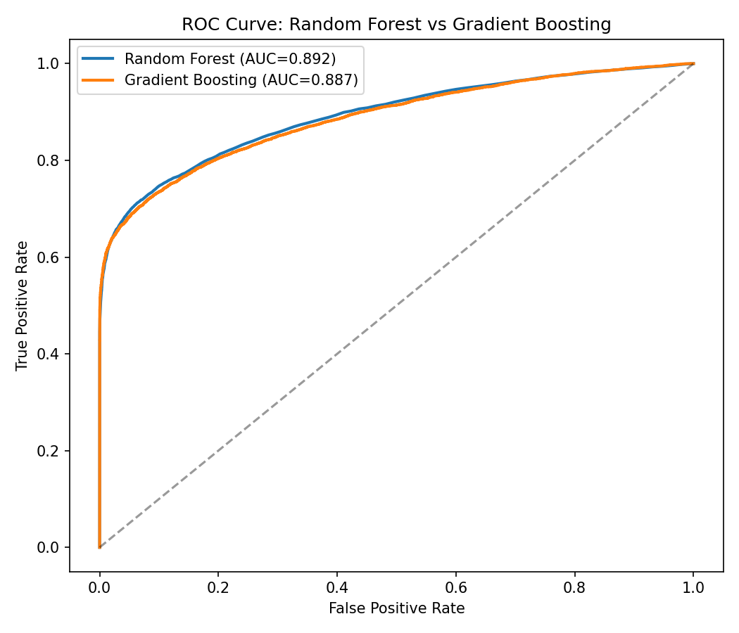
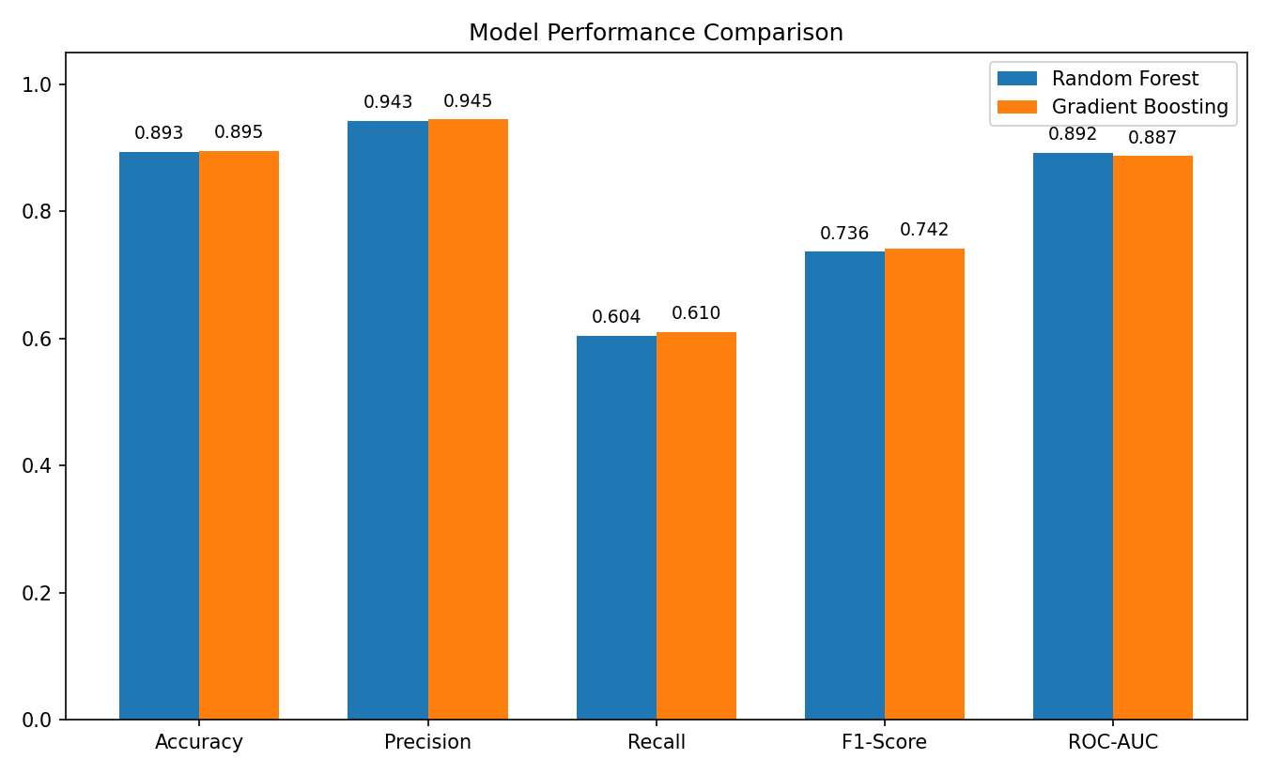
RF vs Gradient Boosting — Our Results

Slide 9
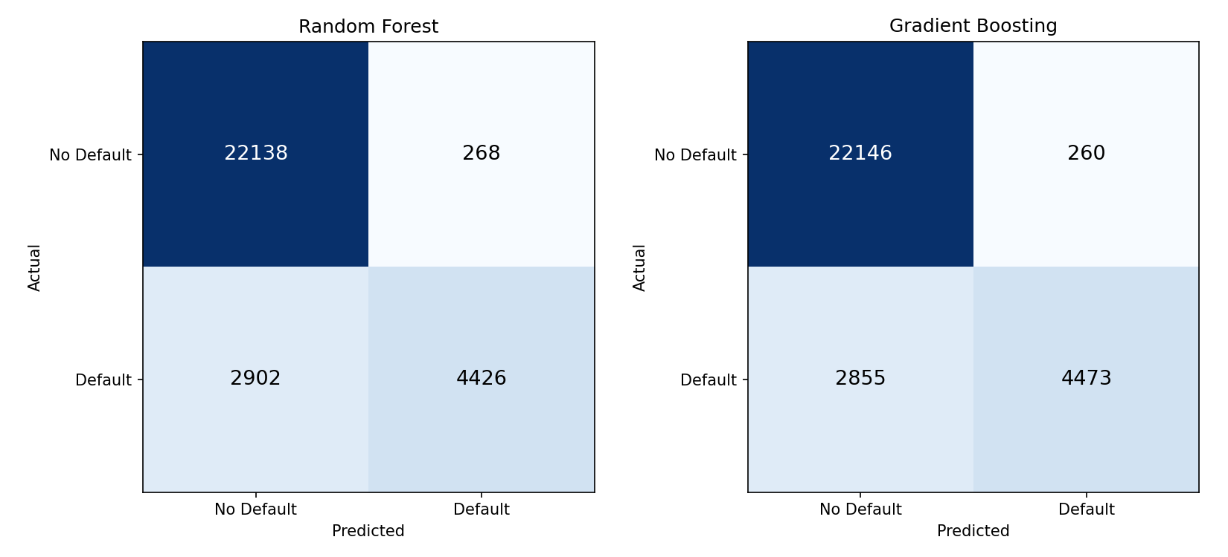
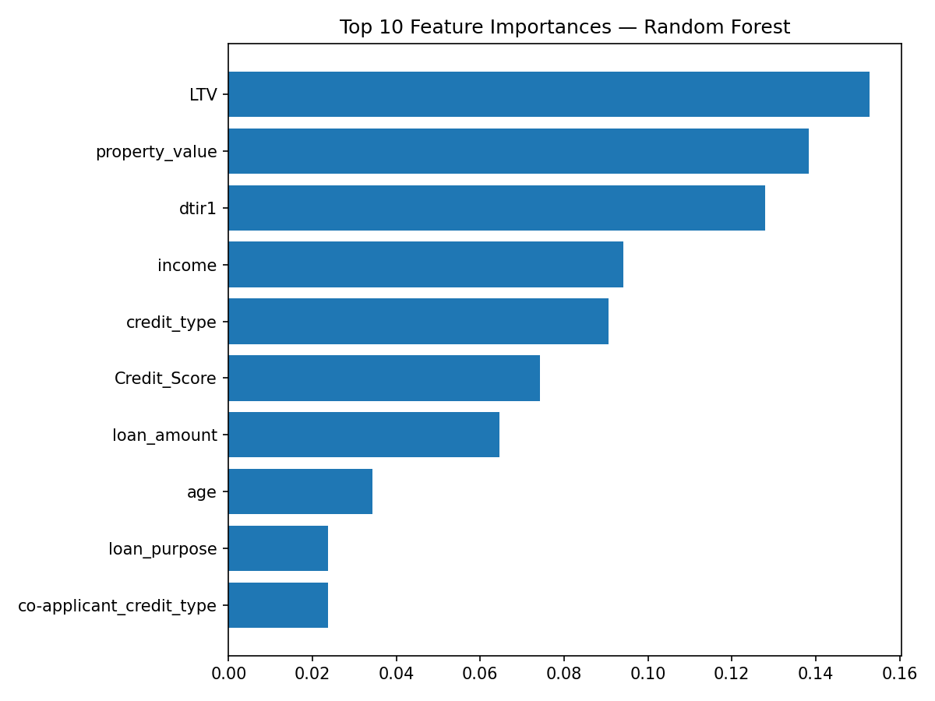
Confusion Matrices & Feature Importance

Slide 10
Versioned Pipeline
Package Pipeline
Serve & Validate
Monitor Health
Retrain Triggers
Governance & Provenance
Pack preprocessing, encoders, model, and probability calibrator; version with Git and artifact store.
Serve via REST API or batch scoring; include input validation and logging.
Track PSI per feature (alert PSI > 0.2), label-rate drift, prediction distribution changes, and business KPIs (default rate among accepted, realized loss).
Retrain when AUC on recent labeled sample drops >0.03 or PSI >0.2 for >2 consecutive months.
Document feature provenance, fairness checks (disparate impact), and an approval workflow for model updates.

Slide 11
Key Takeaways
You now understand the loan-default problem, the data structure, and how targeted preprocessing shapes model performance. You can train, tune, and compare Random Forest and Gradient Boosting with CV and AUC/PR metrics. And you can sketch a simple deployment and monitoring plan that tracks data drift, retraining triggers, and business KPIs.

Slide 12
Thank You

